Slide 1


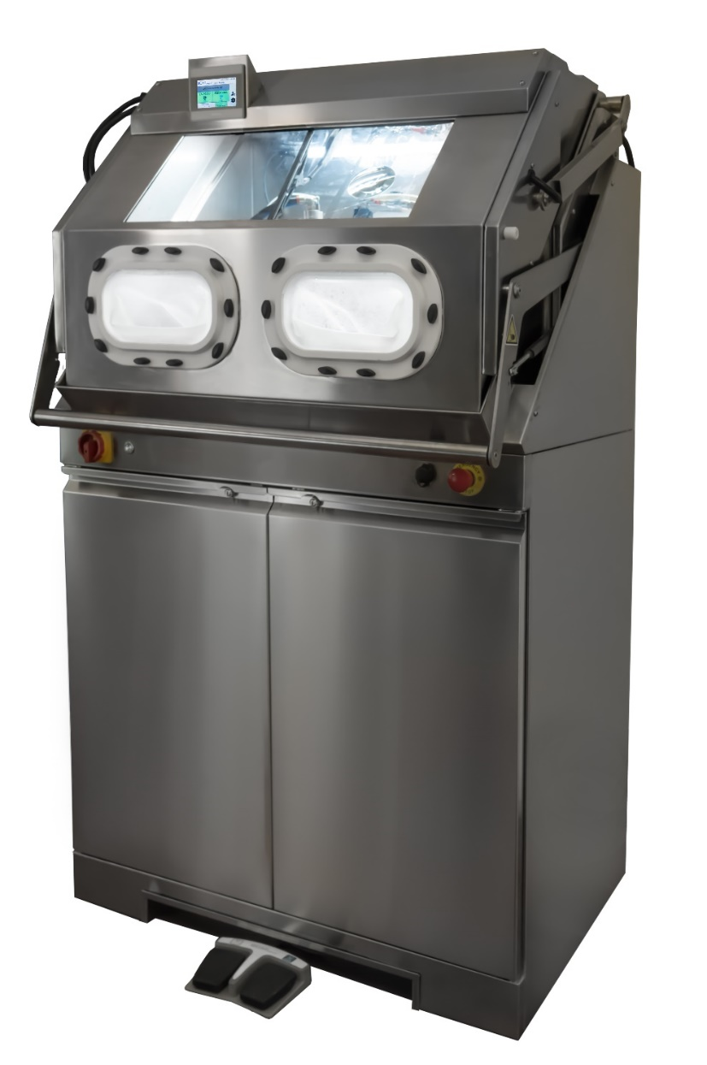
SAFE CleanBox
STK 100
The Revolutionary Cleaning System for Reusable Medical Devices using sodium bicarbondate

Slide 2


ABOUT BICARjet®
Sodium bicarbonate Systems
35 YEARS EXPERIENCE
PARTNER SOLVAY
FOR SODIUM BICARBONATE
8 PATENTS
2 MANUFACTORING PLANTS

Slide 3




Industrial Division
Medical Division

Slide 4

ABOUT BICARmed®
Medical Division of BICARjet ®
BICARmed® Division was created 10 years ago applying the experience of BICARjet ® to RMD’s cleaning:
PARTNERSHIP WITH UNIVERSITY
TESTED BY HOSPITALS
4 INTERNATIONAL PATENTS
8 YEARS OF R&D
ABOUT BICARMED

Slide 5




WHY BICARjet® TECHNOLOGY
Advantages
SAFE
EFFECTIVE
NON ABRASIVE
ENVIRONMENT FRIENDLY
OPERATOR SAFETY
GRANULOMETRY
DEEP CAVITY
SURFACE SAFETY THANKS TO SODIUM BICARONATE ADVANTAGES

Slide 6
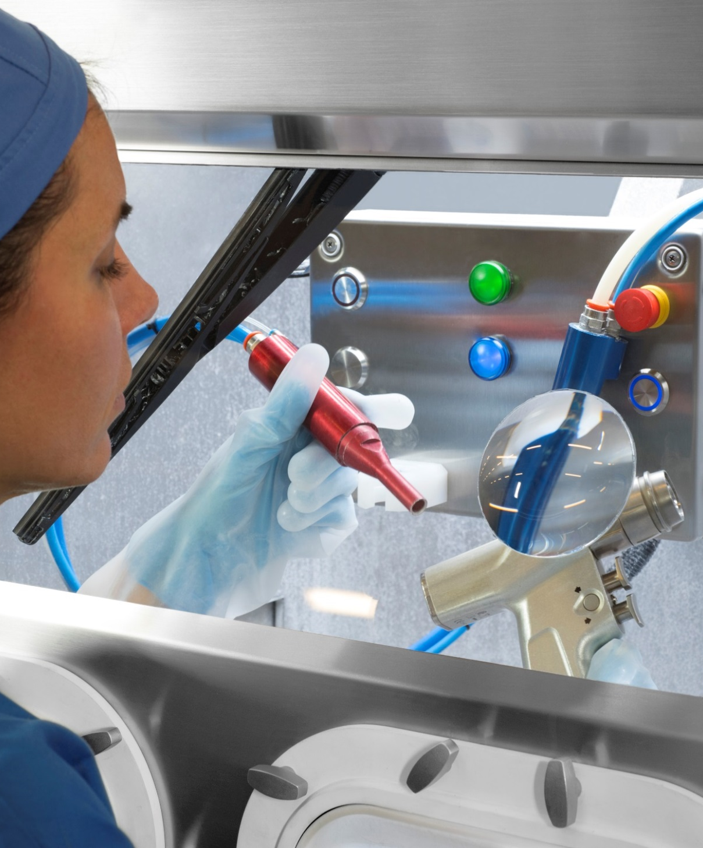
UNIQUE
One way to pre-washing all instruments: endoscopic, stark optics, motor drills, cannulas, fragile tools, generic and specialized instruments.
SAFE
Prevents direct contact between the operator and unsafe contaminants.
The sodium bicarbonate does not alter but preserves the surface of the instruments.
EFFECTIVE
Maximum removal of difficult dirt - bone, cements, glue and dry blood residues -
even on more RMDs with complex geometries.
ECONOMICAL
Significant reduction on maintenance of RMDs.
Wear prevention by oxidation, corrosion, pitting and biofilm extending RMDs’ lifecycle.

Slide 7
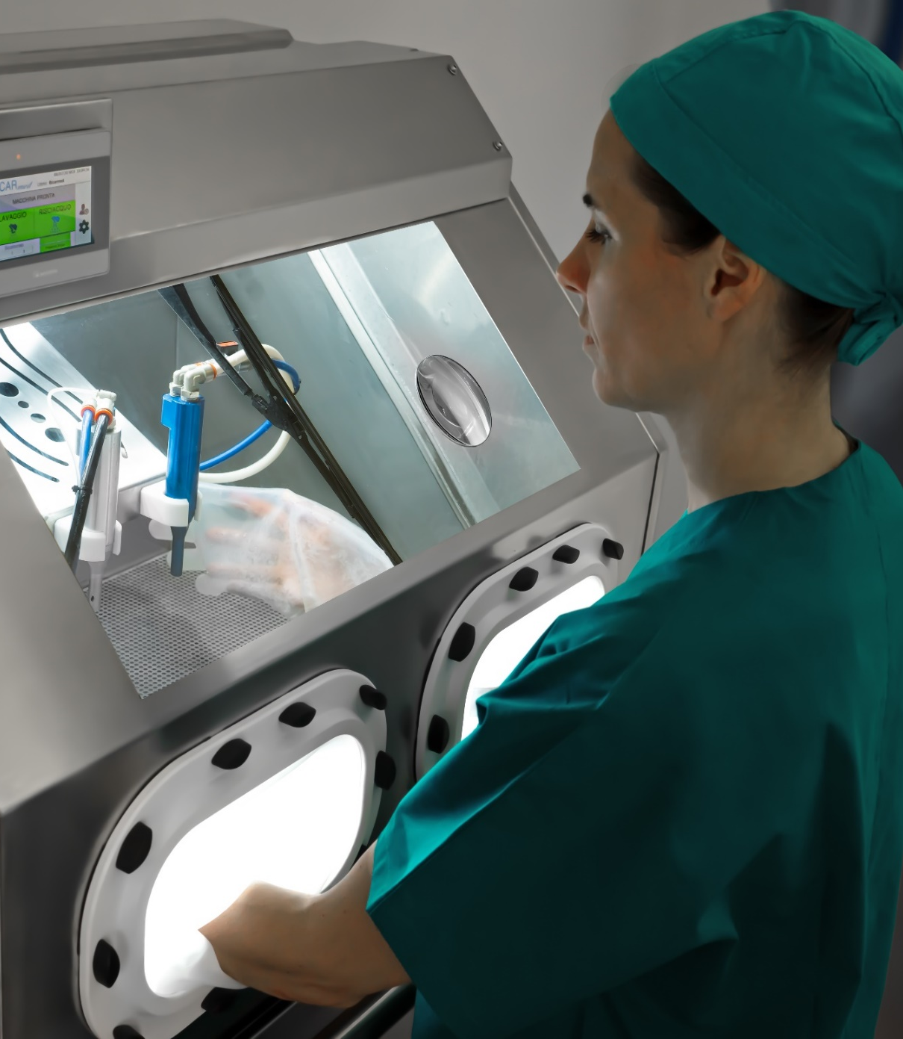
SAFE CleanBox
The sodium bicarbonate cleaning process
SAFE Clean BOX STK100 is a medical device that uses sodium bicarbonate in granules and low pressure compressed air to clean all reusable medical device.
The treatment is effective also on complex shape instrument and critical dirt.

Slide 8
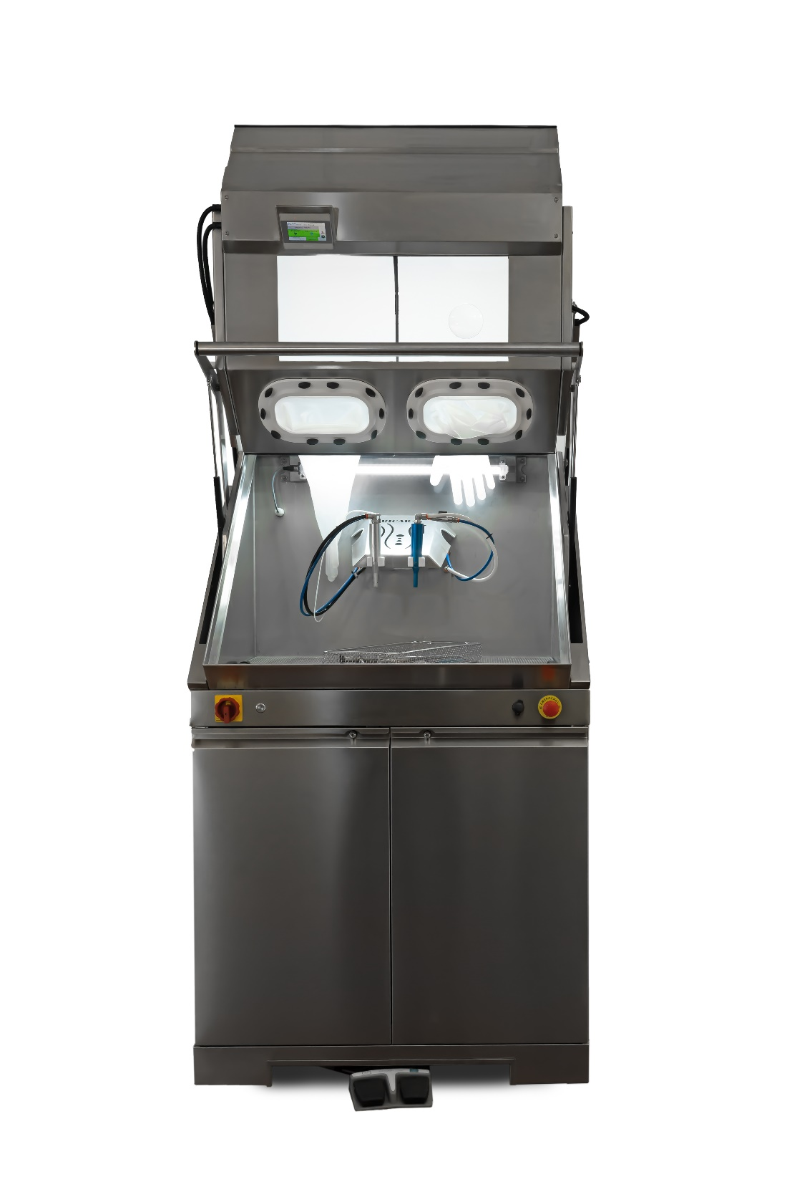
HOW DOES IT WORK
Easy and efficient
A flow of sodium bicarbonate special size with air and water conveyed through a handpiece, strikes the surface uniformly and continuously.
The dirt is thus removed in depth, even from the most complex geometries and with the most adherent contaminants.

Slide 9


SODIUM BICARBONATE: NONCORROSIVE, COMPLETELY SOLUBLE, AND BIODEGRADABLE
Therefore, it does not pollute the environment and it is safe for operators
The mechanical action of the granules has no abrasive effects.
The kinetic energy is absorbed by the granule itself which, after the impact with the surfaces to be cleaned, is destroyed.
Through a second handpiece it is possible the complete rinsing of the tool.
.

Slide 10


QUALITY OF RESULT
BEYOND ALL EXPECTATIONS
An effective cleaning prevents the accumulation of debris deposits on the instruments’ surface, thus reducing instrument damage from oxidation.
Oxidation creates micro holes on RMD surfaces over time (pitting), of difficult, if not impossible, cleanliness, which weakens instruments leading them to early breakage.
Therefore, preventing oxidation will extend the average lifespan of RMDs.

Slide 11
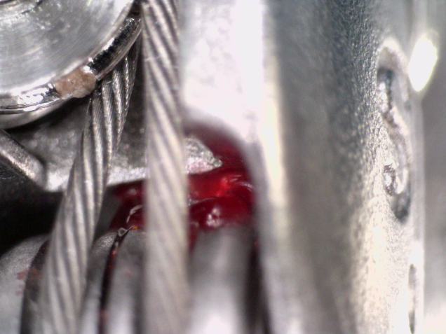
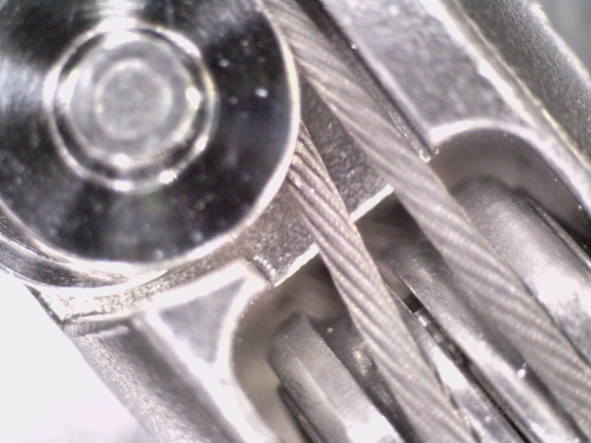
ENSURED MAXIMUM EFFICIENCY
CLEANING COMPLEX INSTRUMENTS
An effective cleaning prevents the accumulation of debris deposits on the instruments’ surface, thus reducing instrument damage from oxidation.
Oxidation creates micro holes on RMD surfaces over time (pitting), of difficult, if not impossible, cleanliness, which weakens instruments leading them to early breakage. Therefore, preventing oxidation will extend the average lifespan of RMDs.
Robotic instrument details

Slide 12


Ensured Maximum Efficiency
Critical Tools
Critical Dirts
TOOLS WITH COMPLEX SHAPES AND GEOMETRIES AS:
  ENDOSCOPIC TOOLS
  CANNULATED TOOLS
  ORTHOPEDIC TOOLS
ELECTROSURGERY TOOLS
DELICATE MICROSURGERY TOOLS
RIGID OPTICS
ROBOTIC TOOLS
NON-SUBMERSIBLE TOOLS
HEAVY DIRT
DRY DIRT
RESIDUES FROM CAUTERIZATION PRACTICES
INORGANIC RESIDUES
BONE RESIDUES
CEMENT RESIDUES
GLUE RESIDUES

Slide 13




Organic tissues fixed on FORCEPS
Before BICARmed treatment
After BICARmed treatment
Organic tissues fixed on
FORCEPS
After BICARmed treatment
Before BICARmed treatment
After BICARmed treatment

Slide 14




Organic tissues fixed on ACETABULUM backside
Before BICARmed treatment
After BICARmed treatment
Organic tissues fixed on
ACETABULUM
backside
After BICARmed treatment
Before BICARmed treatment
After BICARmed treatment

Slide 15




Oxidation on GRIPPER CLAMP
Before BICARmed treatment
After BICARmed treatment
Organic tissues fixed on
DRILL BIT
After BICARmed treatment
Before BICARmed treatment
After BICARmed treatment

Slide 16




Organic tissues fixed on
MONOPOLAR TWEEZERS
Before BICARmed treatment
After BICARmed treatment
Organic tissues fixed on
MONOPOLAR TWEEZERS
After BICARmed treatment
Before BICARmed treatment
After BICARmed treatment

Slide 17




Organic tissues fixed on
BIPOLAR TWEEZERS
Before BICARmed treatment
After BICARmed treatment
Organic tissues fixed on
BIPOLAR TWEEZERS
After BICARmed treatment
Before BICARmed treatment
After BICARmed treatment

Slide 18




Organic tissues fixed on
ENDOSCOPIC FORCEPS
Before BICARmed treatment
After BICARmed treatment
Organic tissues fixed on
ENDOSCOPIC FORCEPS
After BICARmed treatment
Before BICARmed treatment
After BICARmed treatment

Slide 19




Organic tissues fixed on
ENDOSCOPIC FORCEPS
Before BICARmed treatment
After BICARmed treatment
Organic tissues fixed on
ENDOSCOPIC FORCEPS
After BICARmed treatment
Before BICARmed treatment
After BICARmed treatment

Slide 20




Organic tissues fixed on ENDOSCOPIC FORCEPS
Before BICARmed treatment
After BICARmed treatment
Organic tissues fixed on
LAPAROSCOPIC FORCEPS
After BICARmed treatment
Before BICARmed treatment
After BICARmed treatment

Slide 21




Organic tissues fixed on
DA VINCI
ROBOT
Before BICARmed treatment
After BICARmed treatment
Organic tissues fixed on
DA VINCI
ROBOT
After BICARmed treatment
Before BICARmed treatment
After BICARmed treatment

Slide 22




Organic tissues fixed on
DA VINCI
ROBOT
Before BICARmed treatment
After BICARmed treatment
Organic tissues fixed on
DA VINCI
ROBOT
After BICARmed treatment
Before BICARmed treatment
After BICARmed treatment

Slide 23




Organic dried tissues fixed on RIGID OPTIC
Before BICARmed treatment
After BICARmed treatment

Slide 24
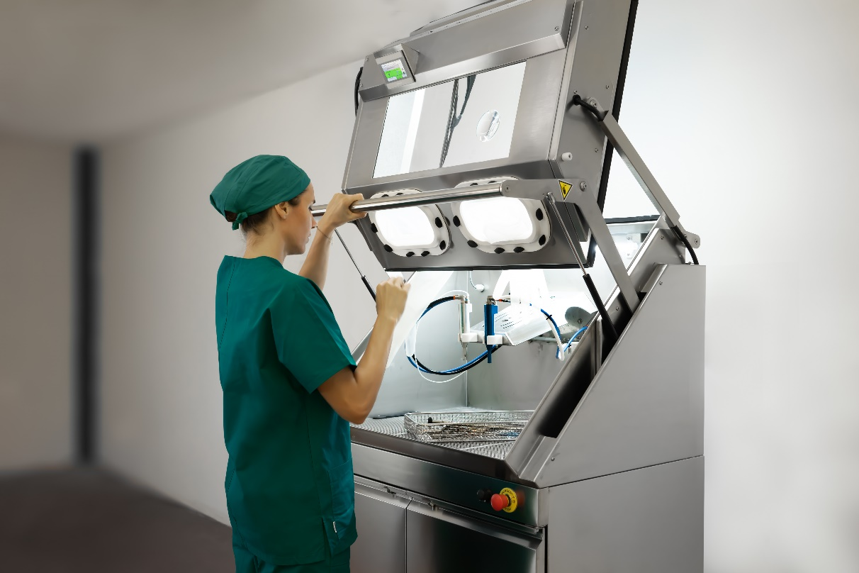
ALL THE CLEANING OPERATIONS
CAN BE DONE WITH THE SAME TECHNOLOGY
COMFORTABLY SEATED
WITHOUT WASTING TIME

Slide 25

Contacts:
info@bicarmed.com
T. +39 049 7808036
BICARmed is the Medical Division of:
Via Nona strada, 4 – 35129 – Padova – Italy
info@bicarjet.com – www.bicarjet.com

